Slide 1


Supply Chain Network Design
April 2024

Slide 2





Meet the Team
Cole Wesley
Madhur Khanna
Nagarjuna Chidarala
Priyam Sarkar
Vishnu Ponduri

Slide 3
AGENDA
BACKGROUND
SUMMARY
METHODOLOGY
MODELING
ANALYSIS OF SCENARIOS
BUSINESS ANALYSIS
WAY FORWARD

Slide 4
Executive Summary
Evaluating the existing network and identifying improvement opportunities optimizing for cost and service
Current LC Locations: 1.Location1, CA 2. Location 2, GA 3. Location 3, TX
Scenario-1 | Scenario-2 | Scenario-3
Greenfield Analysis (GFA) What if we operate with only 5 mega hubs (LCs) servicing the customer directly | Greyfield Analysis (GrFA) What if we pick 3 new LC locations to serve the existing DCs which in turn will serve customers | Brownfield Analysis (BFA) What if we want to move out from Location 1, CA while keeping the existing network as is
Problem Statement
Chicago, IL
Reno, NV
York, PA
Grand Prairie, TX
Columbus, GA
Knoxville, TN
Oklahoma City, OK
Fresno, CA
North Los Vegas, Nevada
Optimal Locations
Cost Optimized: $ 12 M
Service Optimized: $ 5 M
Cost Optimized: $ 0.45 M
Service Optimized: $ 0.25 M
Cost Optimized: $ 0.45 M
Service Optimized: $ 0.45 M
Transportation Costs (Saved)

Slide 5
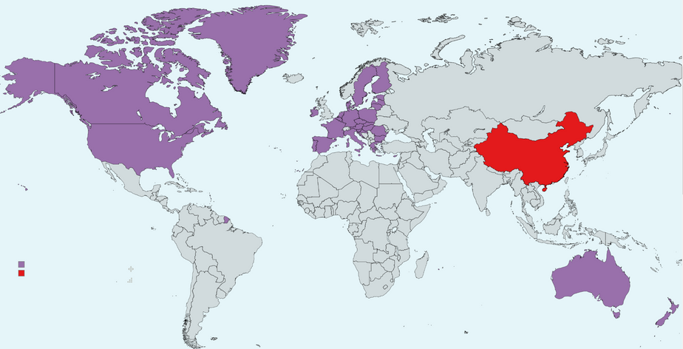
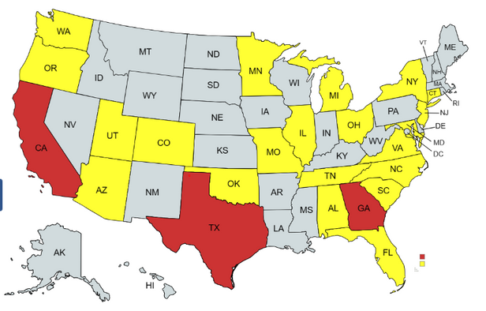


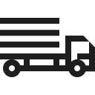





ABC leads the automotive aftermarket with a comprehensive worldwide footprint
ABC strives to empower every enthusiast to pursue their passion
ABC global footprint
ABC CLIENT
Production of goods majorly in China:
Serves over 13,500 retailers across North America, Australia and Europe
DEFINED BY PERFORMANCE
Established in 1995
$1B in global annual revenue
$50M in domestic supply chain
Serves the automotive enthusiast with a wide selection of vehicle enhancements
LC and DC locations in the US
Supply chain overview
Ports
Logistics Center
Distribution Center
Customer
Logistic Centers(LC)
There are two ways to ship goods to the customers
From LC to DC to customers
From LC to the customers directly
Distribution Centers(DC)

Slide 6
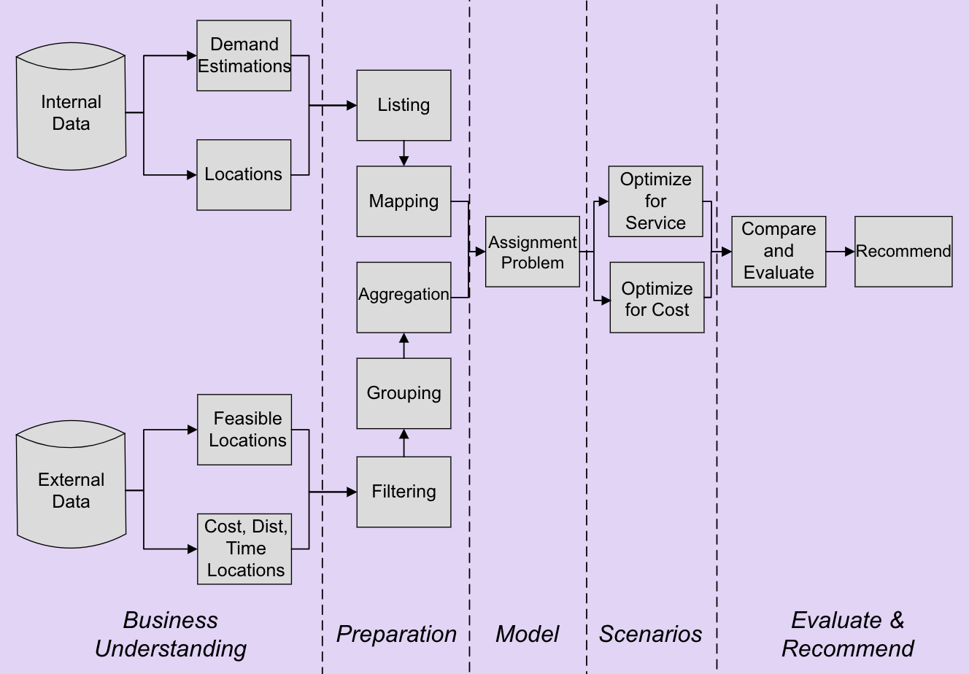




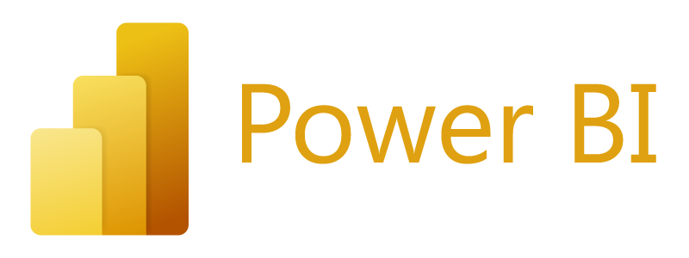


Advanced optimization techniques used multiple data sources to identify optimal locations for cost and service
Tools Used
MS Excel
Python
MySQL
Power BI
Gurobi Solver
Google-OR Tools

Slide 7
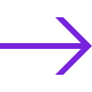


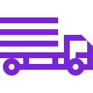
Identifying feasible cities based on business needs and establishing proxies
Data filtering steps
Proxies for analysis:
Cost
Service
Weight*Distance
Distance
30,000 cities
1
Population > 200,000
2
Avg. Income/ year > 70,000
3
All metrics and figures mentioned are on an annual basis.
Data from year 2020 was used with an assumed CGAR of 4%.
Labor and Warehouse costing were not included, and the filtering of cities based on the mentioned criteria was assumed to fulfill the needs of both.
Assumptions:
Feasible Cities 240
4
Final cities after filtration

Slide 8
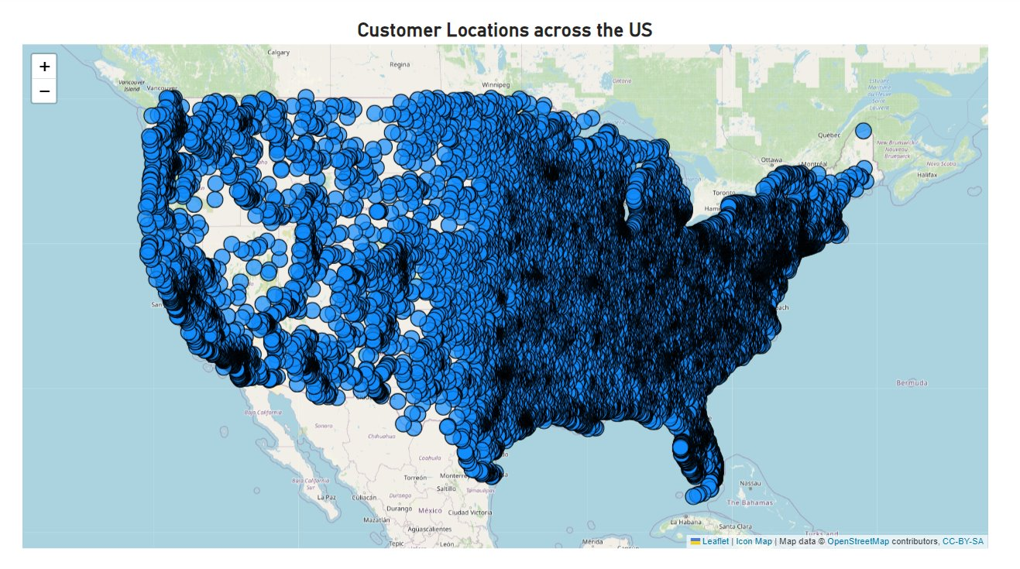
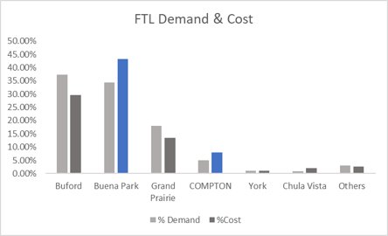
Understanding existing Business metrics to identify gaps in supply chain network
Customer Geographic Distribution
Region | Demand (lb) | Shipment Cost ($)
South | 15.3mn | 2.0mn
West | 11.5mn | 0.7mn
Northeast | 29.5mn | 4.7mn
Midwest | 19.6mn | 2.0mn
Total | 74.8mn | 9.4mn
Key Insights:
Northeast is the highest contributors in terms of demand, constitutes 40% of total
Service cost in West region is higher, contributes 7.6% while caters 6.4% of total demand
For the top contributed warehouses, service cost of CA is higher than average
Warehouse scenario

Slide 9
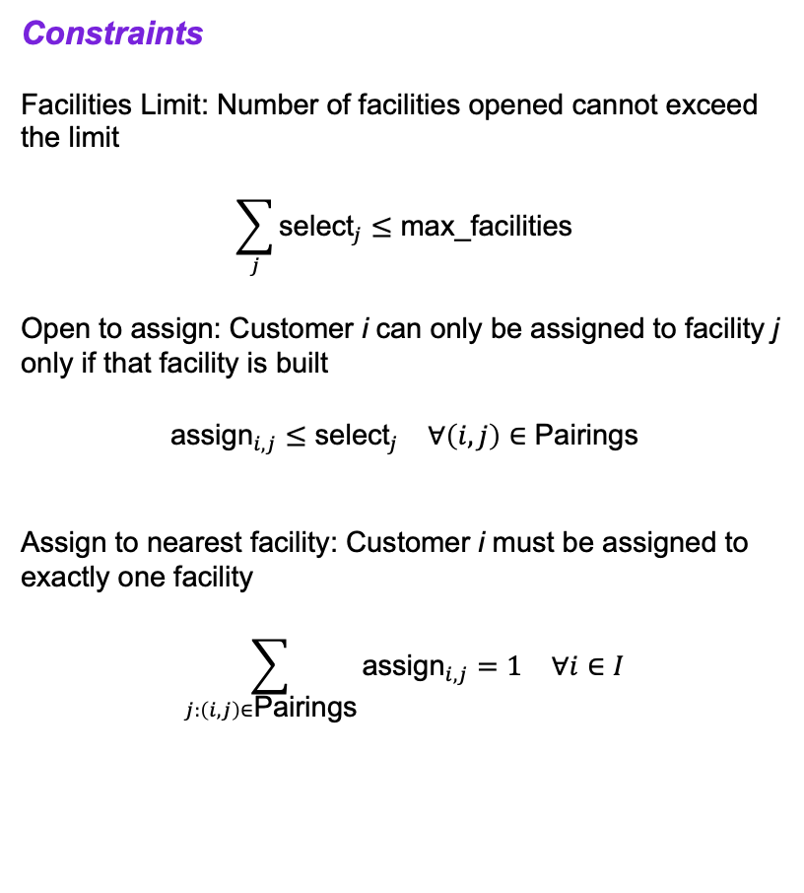
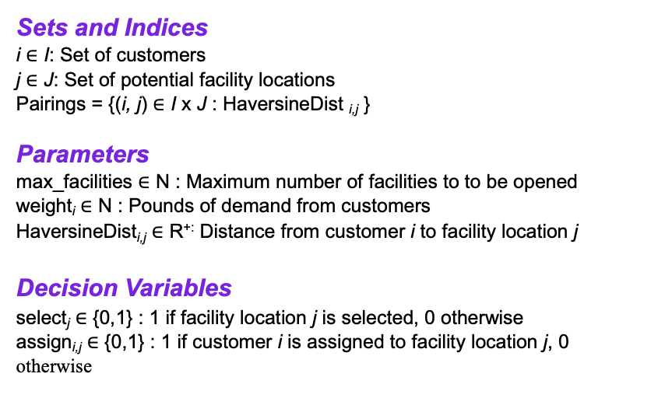
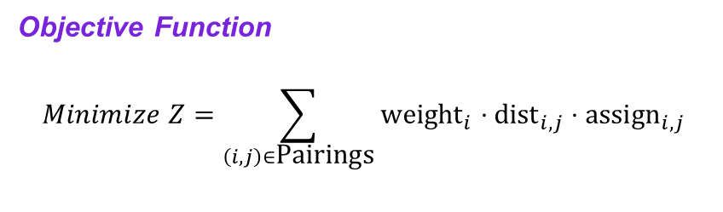
Scenarios are modelled as Integer Optimization Problems to identify the optimal locations
Objective Function
$$Minimize Z=\sum_{\left(i,j\right)∈\text{Pairings}}{{\text{weight}}_{i}}⋅{\text{dist}}_{i,j}⋅{\text{assign}}_{i,j}$$
Constraints
Facilities Limit: Number of facilities opened cannot exceed the limit
$$\sum_{j}{{\text{select}}_{j}}≤\text{max}\text{_}\text{facilities}$$
Open to assign: Customer i can only be assigned to facility j only if that facility is built
$${\text{assign}}_{i,j}≤{\text{select}}_{j} ∀\left(i,j\right)∈\text{Pairings}$$
Assign to nearest facility: Customer i must be assigned to exactly one facility
$$\sum_{j:\left(i,j\right)∈\text{Pairings}}{{\text{assign}}_{i,j}}=1 ∀i∈I$$
Sets and Indices
i $∈$ I: Set of customers
j $∈$ J: Set of potential facility locations
Pairings = {(i, j) $∈$ I x J : HaversineDist _{i,j} }
Parameters
max_facilities $∈$ N : Maximum number of facilities to to be opened
weight_{i} $∈$ N : Pounds of demand from customers
HaversineDist_{i,j} $∈$ R^{+:} Distance from customer i to facility location j
Decision Variables
select_{j} $∈$ {0,1} : 1 if facility location j is selected, 0 otherwise
assign_{i,j} $∈$ {0,1} : 1 if customer i is assigned to facility location j, 0 otherwise

Slide 10

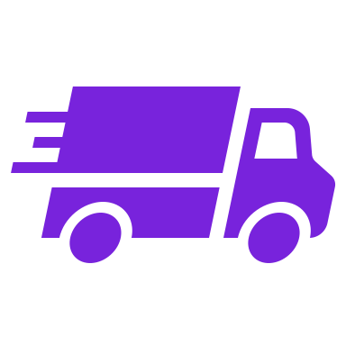
Scenario-1 Identify 5 new optimal LC locations using aggregated demand data
LC 1
Key Task:
1
Create LC-customer linkages instead of DC-customer linkages
LC 2
Transform the linkages into binary variables for integer problem modeling
LC 3
2
LC 4
Identify 5 optimal locations for LCs based on aggregated demand
3
LC 5

Slide 11

Results and insights of the green field analysis
Metrics
LC Location
Travelled
Glendale, CA
Chicago, IL
Dallas, TX
Charlotte, NC
Denver, CO
400M Miles
Cost
Reno, NV
Rockford, IL
McKinney, TX
Atlanta, GA
Harrisburg, PA
340M Miles
Service
Key Insights:
All the distance metrics are annual figures indicating sum total of all orders.
All the cities are new and far from the existing network.​
Dallas, TX is in the vicinity of TX (an existing LC), so it is not advised to move from there.​
This ideal case reduces the total distance travelled in the baseline case by 20%.

Slide 12
Baseline comparison of the 5 LC case suggests recurring cost reduction, but at a heavy initial investment
 | Miles Travelled (in Million) | Cost Incurred (in Million Dollar)
Optimized for Service
Optimized for Cost
Key Insights:
We observe a cost saving of $5 million when optimizing for service versus a saving of $12.5 million when optimizing for cost
Baseline
Proposed
Baseline
Proposed
Baseline
Proposed
Baseline
Proposed

Slide 13
When factoring in the distance from ports to Logistic Centres, the decrease in miles travelled is found to be marginal
Service Level
Miles Travelled (in Million Miles)
Cost Optimization
The savings of 60 million miles in distance justify incurring an additional cost of $8 million.
Prioritizing cost and service optimization prompted cities to shift away from coastal areas.
When accounting for the additional mileage from ports to Logistic Centres, the proposed alternative loses its initial appeal
Service Level
Cost Incurred (in Million Dollars)
Key Insights:
Cost Optimization

Slide 14
Scenario 2 Customer demands are optimally assigned to DCs and DCs are served from optimal LC locations
Stage 2
Stage 1
Key Task:
LC 1
DC1
1
Aggregate demands at customer level
DC2
LC 2
DC3
Assign demands to a DC by optimizing for the cost and service – stage 1
2
DC4
.
.
.
.
.
.
3
Identify optimal locations that minimize the objective - cost or service by assigning the DC demands to the LC Locations selected – stage 2
LC 3
DCn
Flow of approach

Slide 15
Results and insights of the grey field analysis
Metrics
LC Location
Travelled
Glendale, CA
Cincinnati, OH
Oklahoma City, OK
1.3M Miles
Cost
Knoxville, TN
Anaheim, CA
Salt lake City, UT
0.9M Miles
Service
Key Insights:
Distance considered is between Logistic Centres and Distribution Centres.​
Optimal demand at the DC is already solved in stage 1 before proceeding to solve stage 2. ​
California is still the better place from cost savings and service level point of view.

Slide 16
Baseline comparison of the 3 LC case suggests cost reduction and service enhancement
Key Insights:
Cost Incurred (in Million Dollar)
The entire hassle of shifting all the 3 LC's is at most worth $0.45M
We are yet to factor in additional miles to be travelled from ports to these new locations.
Miles Travelled (in Million)

Slide 17

Scenario-3 Freeze 2 existing LCs and find the optimal location for the 3rd LC as an alternative to California
Stage 2
Stage 1
Key Task:
LC 1
DC1
1
Optimize last-mile customer assignments from existing DC
DC2
LC 2
DC3
2
Do not alter existing DC locations
DC4
LC location will be changed to check the scenario
.
.
.
.
.
.
Determine a substitute for the CA location without altering the locations of the other two Logistic Centers​
3
LC 3
DCn
Flow of approach

Slide 18
Upon investigating the results and insights of the grey field analysis, moving out of California does not impact the total miles traveled within the network
Metrics
LC Location
Travelled
Glendale, CA
Location 2, GA
Location 3, TX
1.1M Miles
Cost
North Las Vegas, NV
Location 2, GA
Location 3, TX
1.07M Miles
Service
Key Insights:
Distance for the network is the distance between LC and DC.
Optimal demand at the DC is already solved in the stage -2.
Service and cost results are the same, irrespective of staying or moving out of CA.

Slide 19
Incorporating warehouse costs supports the feasibility of moving out of California to adjacent state Nevada, hinting at estimated savings of $1 million in real estate alone
Rental Index of 3 cities checked at the vicinity of California to set up alternate Logistic center.
Without travel from ports
3.11
California
Washington
99.4
1.82
Nevada
85.2
74.0
With travel from ports
3.35
Distance from port of LA to feasible LC location has considered.
3.15
Business Solution
Optimal Solution
Key Insights:
Evaluating port proximity revealed that optimal solution requires significantly higher capital investment, prompting a strategic preference for updating location allocations within the existing demand framework.
Las Vegas and Reno emerge as viable new Logistic Centre locations, offering a balanced approach without extensive distribution network alterations
Data-driven analysis identifies Las Vegas as the superior choice

Slide 20
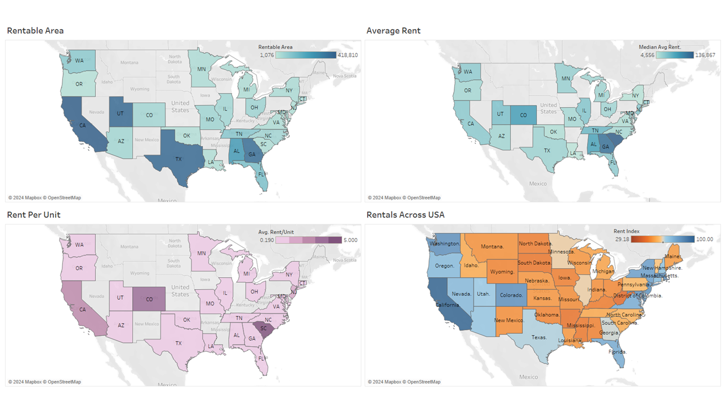
Developing a commercial rental index
Commercial Rental Index

Slide 21
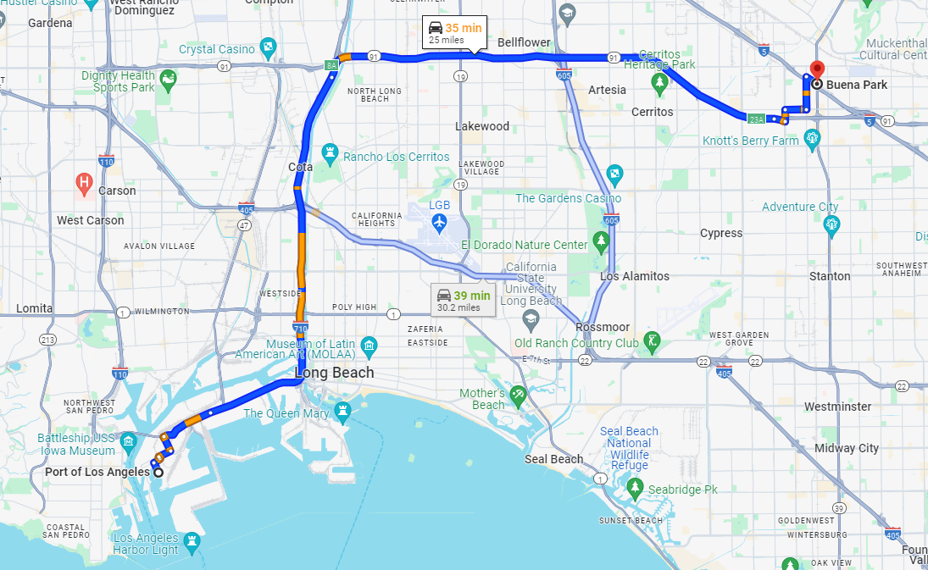
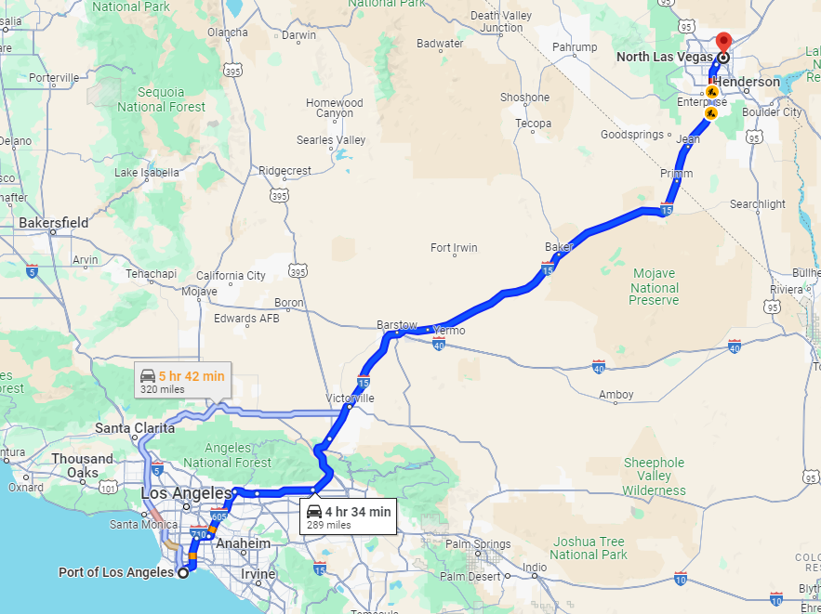
Pros & Cons assessment to analyze business sense in moving out of California, incorporating labor and tax costs
Lesser real estate cost
Estimated rental savings are $80k per month ($1 million annually).
Corporate income tax savings No corporate income tax levied in Nevada compared to 8.84% in CA. (one of the highest in the country)
Staffing costs
Min Wage is Nevada is $10.25 compared with $16 in California.
Pros
Distance
Increase of approx. 275 miles leads to increased transportation costs and could impact service levels.
Human Resource
It is assumed that human resources in both quantity and quality will be better in CA.
Cons

Slide 22

Way Ahead
Modeling Perspective
The current model of assignment-based optimization could be remodeled as a facility location min-cost flow problem for more robust results
This could help us bring in controllability at many factors such as limitations at DCs and efficient routing of goods
Inclusion of costs of sending goods from ports to LCs
Deployment
Tying this model with Demand forecasting can fuel timely and efficient routing improving cost efficiency

Slide 23
THANK YOU!

